Slide 1
DATA ANALYSIS - CAR PRICE PREDICTION DATASET

Slide 2
ROADMAP
DATA CLEANING
DATA WRANGLING
DATA ANLYSIS & OBSERVATION
1
3
5
2
4
DATA HANDLING
DATA TRANSFORMATION

Slide 3
INITIAL DATA CLEANING WITH TEST & TRAIN DATA
Data.shape
Finding out the shape of the data with this function.
Categorical columns
Separated the categorical columns and viewed their sub options with - dtype == 'object’ and value count function. Checked for unique values
Treated nulls
Used replace function to remove unique datetime function .Treated null with mode method and used date time function for dates . Removed duplicates from ‘Varient’ using df = df.dropna(subset=drop_na, axis=0)
Checked for any missed values with: sns.heatmap(df.isnull(), cbar=False, cmap='PuBu')
Checked for unique values and correlations in numerical data
Separated the categorical and compared them with Price(target column) with sns.scatterplot
Removed outliers
df.skew method used to check them as per rank. Used Power transform & Standard scalar to remove skewness & outliers

Slide 4
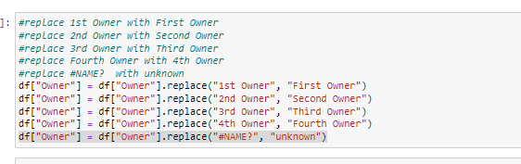
DATA ANALYSIS-DATA MANIPULATION/WRANGLING
#Driven Kilometers & Brand & Model have the highest correlation with Price
Driven Kilometers & Transmission is showing skewness
Used r2_score to calculate the scores for linear regression
Label Encoding
Converted categorical data into numerical to plot graphs, transform dataand scale with Satandard Scalar
Correlation
Found correlation between features with corr() function & correlation matrix
Treating same categories with different names. :
Eg: 1st Owner and 1st owner are the same

Slide 5
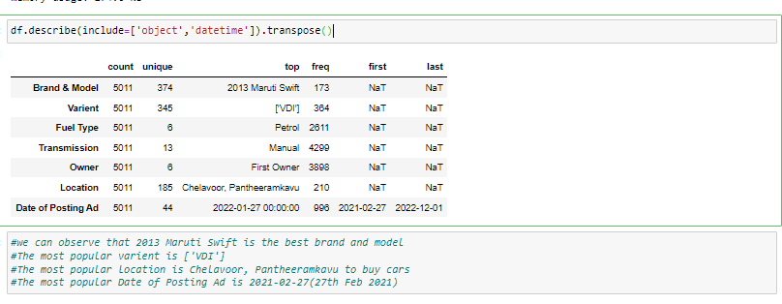
RELATIONS
RELATIONS
With the transpose method , we can conclude the following insights
#we can observe that 2013 Maruti Swift is the best brand and model
#The most popular varient is ['VDI']
#The most popular location is Chelavoor, Pantheeramkavu to buy cars
#The most popular Date of Posting Ad is 2021-02-27(27th Feb 2021

Slide 6
OBSERVATIONS
The maximum drivers own 1st hand cars
The maximum car drivers use petrol
#majority drivers prefer manual transmissions
As the data is scraped from 3 different websites there are same categories with different names in the same column
Diesel fetches the highest in price in the ‘Fuel Type’ category
Automatic fetches the highest price in the transmission feature column category
Ads posted in Feb 2022 had the most sales
The cars that were driven the least per kilometer gathered more price
4+ and 4th owner fetches the least price in the market
Random Forest and Decision Tree are the best methods. However Random forest was the best fit with the regression line

Slide 7
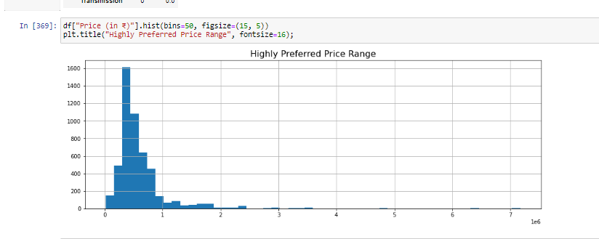
OBSERVATIONS

Slide 8
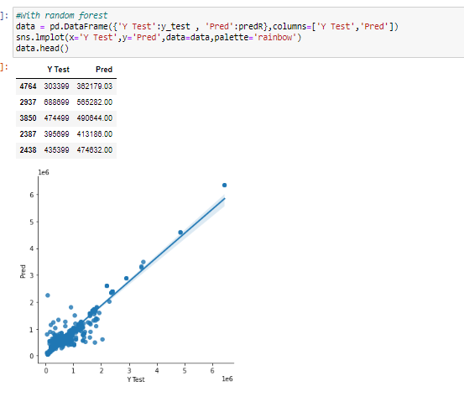
OBSERVATIONS
Following algorithms used for the training and testing
Random Forest
Decision Tree
Ada Boost
Linear regression
Decision Tree: 99%
Random Forest – 98.5%

Slide 9
THANKS!

